Slide 1
iTPU
Regression Algorithms
Predict a number, then a probability
Topic 9 | 90-minute interactive lesson | Real data: a garment factory
Linear - Polynomial - Ridge - Lasso - Logistic
Notes:
Welcome. Today we learn the most-used family of ML models. Everything runs on one real dataset: productivity of garment factory teams - the same data the AutoCode test uses. Phones out for Menti.

Slide 2
Agenda
Today's journey - 90 minutes
0-5 min
Warm-up
Menti: guess a team's productivity
5-35 min
PART 1 Linear regression
the line, MSE, OLS vs gradient descent, polynomial, overfitting, twin features
35-58 min
PART 2 Regularization
Ridge (L2), Lasso (L1), choosing lambda, normalisation
58-82 min
PART 3 Logistic regression
sigmoid, threshold, log-loss, odds
82-90 min
Practice + final challenge
AutoCode preview, Menti leaderboard, exit ticket
Tags: MENTI = vote on your phone ACTIVITY = solve it yourself on paper
iTPU
Topic 9 | Regression Algorithms
Notes:
Three parts, each with activities you solve on your own and Menti quizzes.

Slide 3
MENTI | Open ended
~3 min
menti.com code: ____ ____
A sewing team: target 0.80, bonus 98, 59 workers, 7080 overtime minutes. Guess its REAL productivity (a number between 0 and 1.2).
Live answers appear here on Menti
Type one number on menti.com
Notes:
Real answer: 0.94 (row 1 of the dataset). Show the spread of guesses. Say: your brain just combined several numbers into one prediction - that is exactly what regression does, but with learned weights instead of gut feeling.

Slide 4
Goals
~1 min
By the end of today you can...
Build
Classify
Regularize
Distinguish
and interpret a linear regression model
with logistic regression and a threshold
with Ridge and Lasso to stop overfitting
linear vs non-linear (polynomial) regression
One formula runs through everything today: ŷ = X · w
iTPU
Topic 9 | Regression Algorithms
Notes:
The four session outcomes. Point at the band: every model today starts from the same weighted sum (Topic 6 dot product).

Slide 5
PART 1
Linear regression
Draw the best straight line through the data
Notes:
Start with the simplest and most interpretable model in ML.

Slide 6
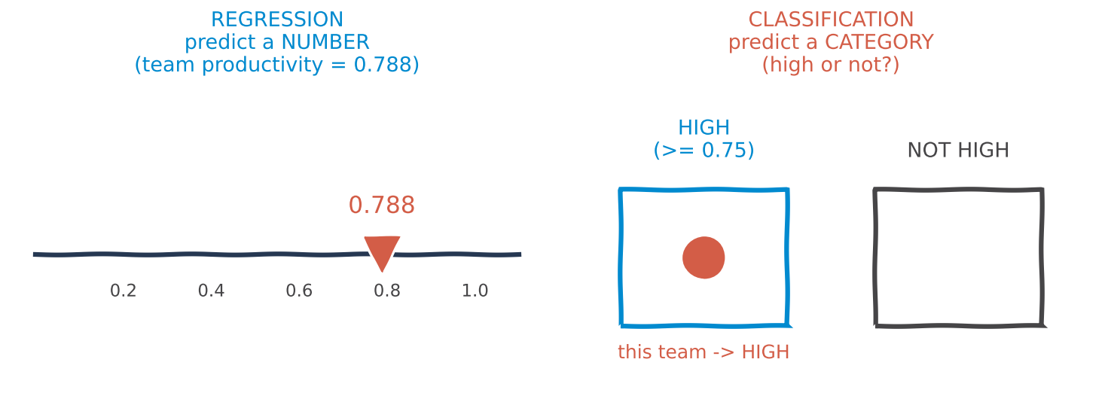
Two jobs
~2 min
Regression vs classification
REGRESSION predicts a NUMBER: price, temperature, productivity | CLASSIFICATION predicts a CATEGORY: spam or not, pass or fail | Trap: logistic REGRESSION does classification!
In ML: the target type decides the model and the loss function you use.
iTPU
Part 1 | Linear regression
Notes:
Left: a number on a line. Right: a team dropped into a bucket. Ask: predicting exam SCORE vs predicting PASS/FAIL - which is which?

Slide 7
Two meanings
~2 min
'Regression algorithm' has two meanings
Broad sense
Narrow sense - TODAY
ANY algorithm that predicts numbers.
Decision trees, k-nearest neighbours, neural networks, gradient boosting...
(later topics)
Algorithms born in STATISTICS:
target = formula(features) + random noise
(noise usually Gaussian - Topic 8)
Linear, polynomial, Ridge, Lasso, logistic
Narrow-sense models are fast, simple and INTERPRETABLE: you can read every weight.
iTPU
Part 1 | Linear regression
Notes:
Clarify the two meanings from the course outline. We focus on the narrow, statistical family. The noise assumption links back to the Gaussian from Topic 8.

Slide 8
Real ML
~2 min
Where these models work every day
Linear
Polynomial
Ridge / Lasso
Logistic
house and car prices
demand forecasting for shops
factory output planning (today!)
growth curves
temperature over a day
fuel use vs speed
genetics: 20,000 genes
text: thousands of words
finance: many correlated indicators
credit approval (default: yes/no)
spam and fraud filters
medical risk scores
Banks and hospitals often prefer these simple models because every weight can be explained to a regulator or a doctor.
iTPU
Part 1 | Linear regression
Notes:
Ask: which of these have you used without knowing? Loan apps, spam filters, delivery-time estimates.

Slide 9
MENTI | Quick fire
~2 min
menti.com code: ____ ____
Regression (number) or classification (category)? Vote for each:
1) Tomorrow's temperature in Fergana
2) Is this bank transaction fraud?
3) Price of an apartment
4) Which digit (0-9) is in this image?
5) A student's exam score out of 100
Set up 5 Menti questions: 'Regression' / 'Classification'
Notes:
Answers: 1 R, 2 C, 3 R, 4 C, 5 R. Bonus question: 'Will the student pass?' is classification even though it comes from the score.

Slide 10
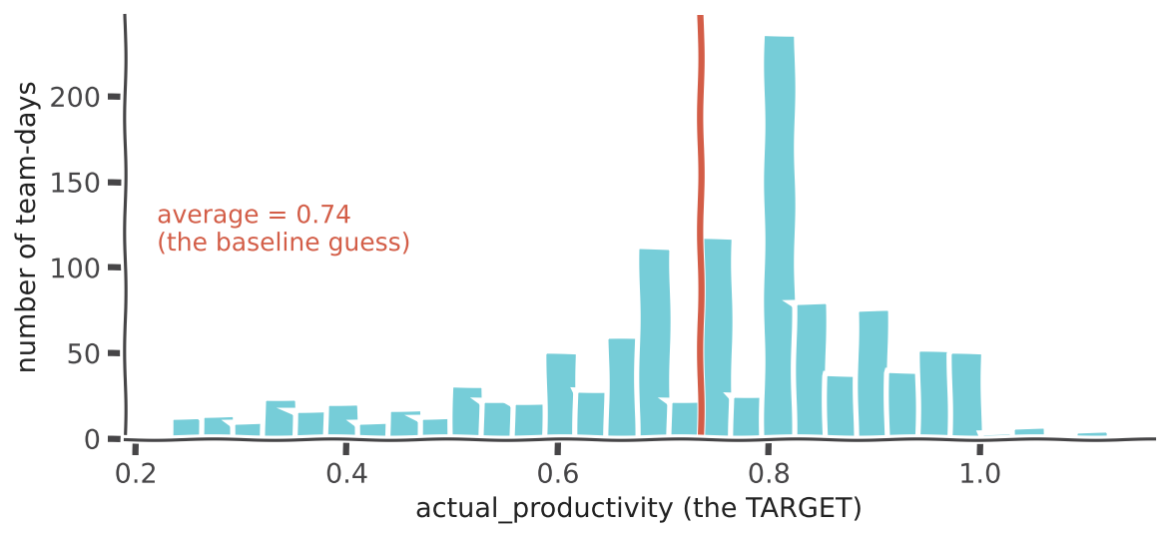
Our data
~3 min
Meet the garment factory dataset
KEY IDEA
1,197 team-days, sewing and finishing departments
TARGET: actual_productivity (0.23 to 1.12)
FEATURES: target set by managers, smv (minutes per garment), overtime, bonus, idle time, number of workers...
Baseline: always guess the average 0.74
In ML: a useful model must beat the baseline - one AutoCode test checks exactly this.
iTPU
Part 1 | Linear regression
Notes:
Explain a row: a team on a given day. smv = standard minute value, how complex the garment is. The red line is the dumbest possible model: always predict 0.74. Everything today must beat it. Source: UCI Machine Learning Repository.

Slide 11
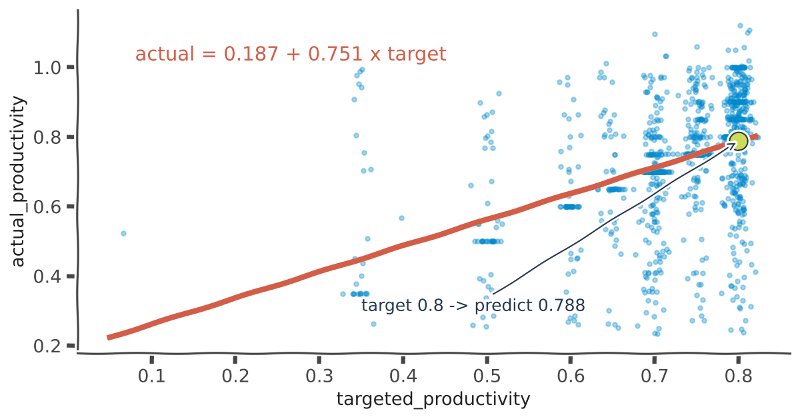
The line
~3 min
Linear regression: the best straight line
KEY IDEA
ŷ = b₀ + b₁ · x
b₀ = intercept (start value), b₁ = slope (effect of x)
Real model: actual = 0.187 + 0.751 × target
Target 0.8 -> predict 0.788
In ML: read it: +0.1 in the target gives +0.075 in real productivity.
iTPU
Part 1 | Linear regression
Notes:
Each blue dot is a team-day. The red line is the fitted model. Interpretation is the superpower: raising a team's target by 0.1 raises real output by only 0.075 - teams reach about three quarters of any extra target.

Slide 12
The formula
~2 min
Many features: multiple linear regression
ŷ = b₀ + b₁x₁ + b₂x₂ + ... + bₙxₙ = X · w
x - features
w - weights
ŷ - prediction
the inputs we know:
target, overtime, bonus, workers...
learned from data:
one number per feature,
plus the intercept b₀
a weighted sum = a dot product (Topic 6)
Each weight = change in ŷ when that feature goes up by 1, with all other features held constant.
iTPU
Part 1 | Linear regression
Notes:
Same idea with many features. Stress 'with the others held constant' - that is how we read a weight.

Slide 13
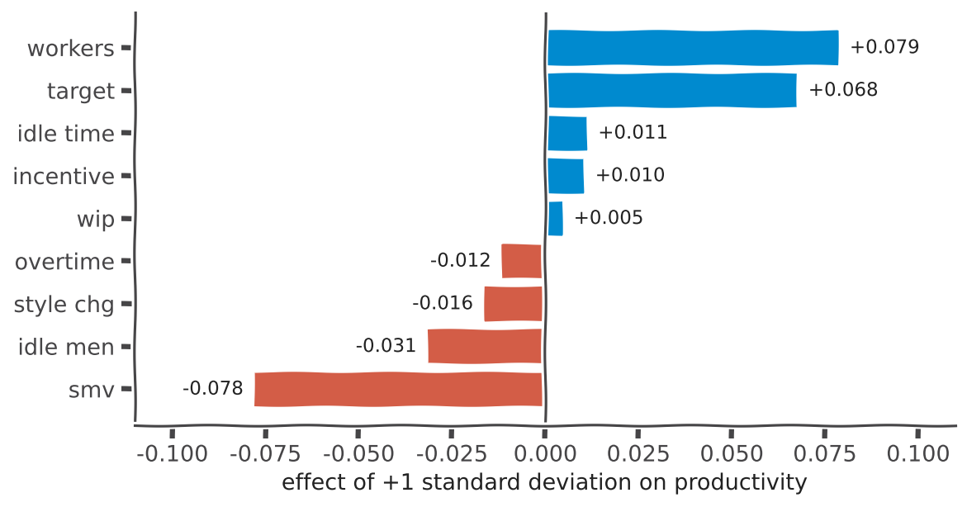
Reading weights
~3 min
What drives productivity? (all 9 features)
KEY IDEA
Features standardised: weight = effect of +1 standard deviation
Raise productivity: workers +0.079, target +0.068
Lower it: smv -0.078, idle men -0.031
Test MSE 0.0217 vs baseline 0.0291 (25% better)
In ML: a manager can read this chart - that is why linear models are used in industry.
iTPU
Part 1 | Linear regression
Notes:
Blue bars push productivity up, red bars push it down. Complex garments (smv) lower productivity; idle workers lower it. Keep an eye on smv and workers - almost equal and opposite. We come back to them.

Slide 14
ACTIVITY | on your own
~4 min
Be the model
YOUR TASK
1. Model: actual = 0.187 + 0.751 × target. Predict for target = 0.7
Use the models on the right
Calculate on paper
3 minutes, then compare with a neighbour
2. Same model, target = 0.5. Prediction?
3. House model (thousand $): price = 20 + 3 × size + 5 × rooms. Size 50 m², 2 rooms?
4. Which adds more to the price: +1 room or +2 m²?
iTPU
Part 1 | Linear regression
Notes:
Answers next slide. Walk around (virtually) and check.

Slide 15
Answers
~1 min
Be the model - answers
1. target 0.7
0.187 + 0.525 = 0.713
2. target 0.5
0.187 + 0.376 = 0.563
3. size 50, rooms 2
20 + 150 + 10 = 180 thousand $
4. +1 room vs +2 m²
+5 vs +6 -> 2 m² adds more
Q4 trap: you cannot compare raw weights (5 vs 3) - they depend on UNITS. Remember this for regularization!
iTPU
Part 1 | Linear regression
Notes:
Q4 prepares the normalisation idea in Part 2.

Slide 16
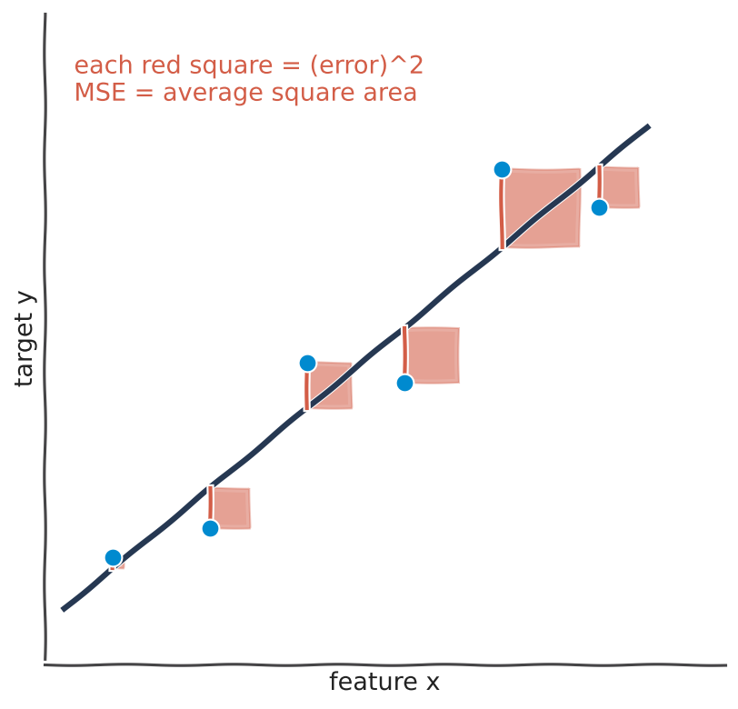
Is it good?
~3 min
Residuals and the mean squared error (MSE)
KEY IDEA
Residual = real - predicted (the red line)
Square it: no cancelling, big errors punished more
MSE = average of the red squares
Best line = the smallest MSE
In ML: MSE is the LOSS the model minimises during training (Topic 7).
iTPU
Part 1 | Linear regression
Notes:
Literally draw it: each error becomes a square. A line far from a point makes a huge square. Training = move the line until the total square area is as small as possible.

Slide 17
ACTIVITY | on your own
~4 min
Compute the MSE
YOUR TASK
1. Real: 0.80, 0.70, 0.60. Model A predicts 0.75, 0.70, 0.70. Errors of A?
Three teams, two models
Error = real - predicted
MSE = average of squared errors
Which model is better?
2. MSE of model A?
3. Model B predicts 0.78, 0.72, 0.62. MSE of model B?
4. Which model wins, and why?
iTPU
Part 1 | Linear regression
Notes:
Answers next slide.

Slide 18
Answers
~1 min
Compute the MSE - answers
1. Errors of A
0.05, 0.00, -0.10
2. MSE of A
(0.0025 + 0 + 0.0100) / 3 = 0.0042
3. MSE of B
(0.0004 × 3) / 3 = 0.0004
4. Winner
B: small errors everywhere; A has one big miss
Squaring makes A's single 0.10 miss cost 25 times more than a 0.02 miss.
iTPU
Part 1 | Linear regression
Notes:
Emphasise how squaring punishes big errors.

Slide 19
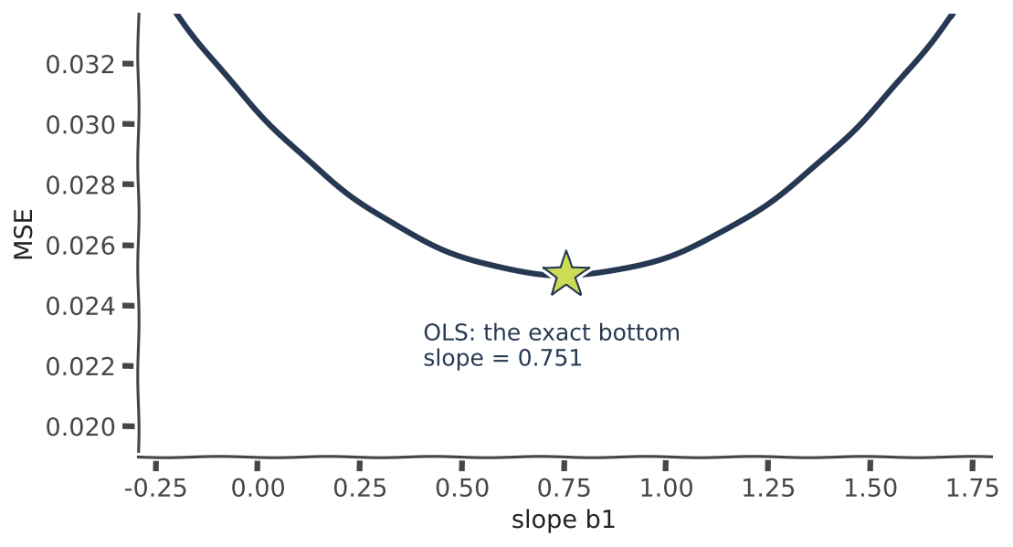
OLS
~3 min
OLS: jump straight to the bottom
KEY IDEA
MSE against the weights is a bowl
Ordinary least squares solves it exactly:
b = (XᵀX)⁻¹ Xᵀ y (Topic 6!)
Real slope found: 0.751
In ML: sklearn's LinearRegression uses a stable version of this formula.
iTPU
Part 1 | Linear regression
Notes:
The bowl from Topic 7. OLS is the calculus answer: set the gradient to zero and solve - one formula, no iterations.

Slide 20
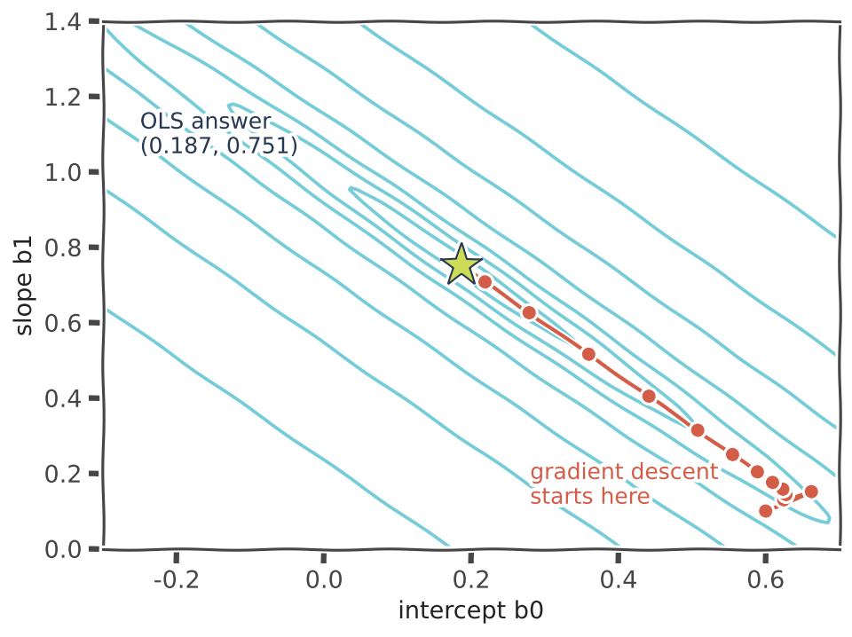
In practice
~3 min
...but in practice gradient descent walks there
KEY IDEA
Inverting XᵀX costs about n³ and needs all data in memory
Gradient descent: w ← w - lr × gradient of MSE
Cheap steps, works with mini-batches and huge data
Arrives at the same answer (0.187, 0.751)
In ML: your AutoCode base class trains exactly like this - you write the gradient.
iTPU
Part 1 | Linear regression
Notes:
Rings are equal-MSE lines. The red path is real gradient descent on our data, the star is the OLS answer. The long narrow valley shows why the path curves - the two weights are related.

Slide 21
MENTI | Quiz
~2 min
menti.com code: ____ ____
Your dataset has 1 million features. What is the best way to fit linear regression?
A) Use the OLS formula once
B) Gradient descent (with mini-batches)
C) Guess the weights
D) Delete features until OLS is fast
Vote on your phone now - 45 seconds
Notes:
Answer: B. Inverting a 1,000,000 x 1,000,000 matrix is impossible in practice; gradient descent scales.

Slide 22
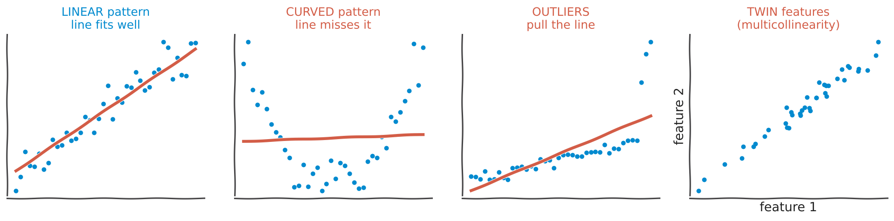
Limits
~3 min
When a straight line is not enough
Linear pattern: the line works | Curved pattern: the line misses it | Outliers pull the line (Topic 5) | Twin features: unstable weights
In ML: always plot the data first - the pattern tells you which fix you need.
iTPU
Part 1 | Linear regression
Notes:
Four situations. The next slides fix the curve (polynomial features) and the twins (feature selection and regularization).

Slide 23
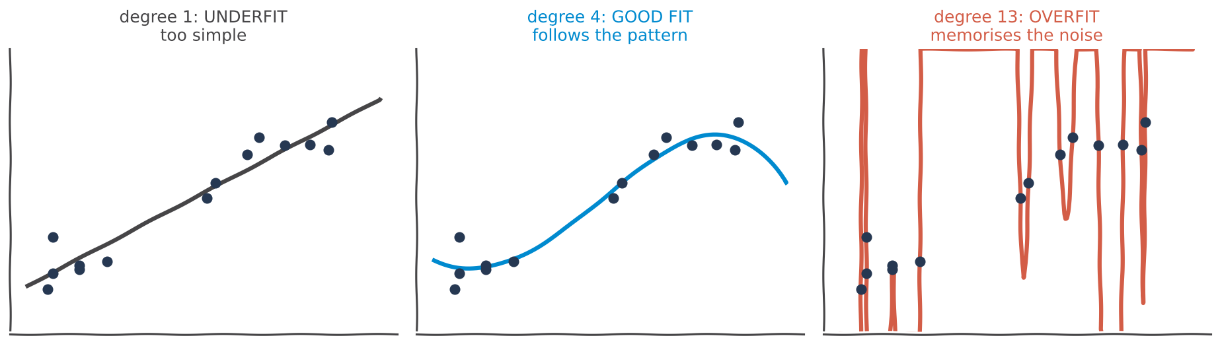
Non-linear
~3 min
Polynomial regression: let the line bend
Add new columns: x², x³, ... up to degree d | Still LINEAR in the weights -> same algorithm | Or handcraft features: overtime², bonus × workers | More degree = more bending = more risk
In ML: feature engineering (Topic 5) turns a linear model into a curve-fitter.
iTPU
Part 1 | Linear regression
Notes:
Same 14 points, three degrees. Degree 1 is too stiff, degree 4 follows the shape, degree 13 draws a crazy curve through every dot - including the noise.

Slide 24
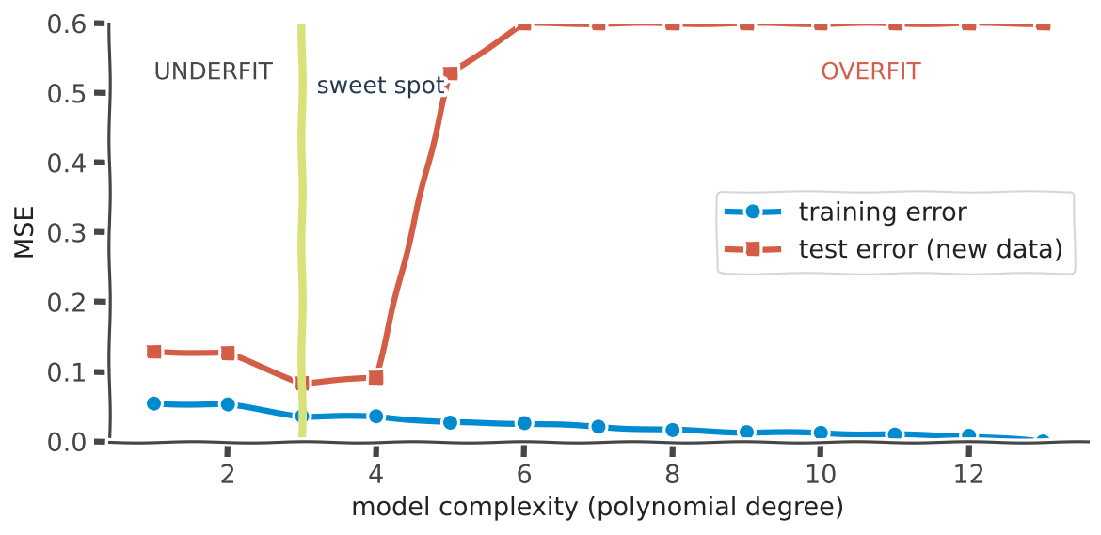
Over vs under
~3 min
Underfitting vs overfitting
KEY IDEA
Training error always falls as the model gets more complex
Test error falls, then shoots up
Underfit: too simple. Overfit: memorises noise
Pick complexity with VALIDATION data
In ML: an overfit model is great on last month's teams and useless on next month's.
iTPU
Part 1 | Linear regression
Notes:
The single most important picture in ML. The model that is best on training data is NOT the best model.

Slide 25
MENTI | Quiz
~2 min
menti.com code: ____ ____
Training MSE = 0.001, but test MSE = 0.40. What happened?
A) Underfitting
B) Overfitting
C) A perfect model
D) The test set is too small
Vote on your phone now - 45 seconds
Notes:
Answer: B. A huge gap between training and test error is the signature of overfitting.

Slide 26
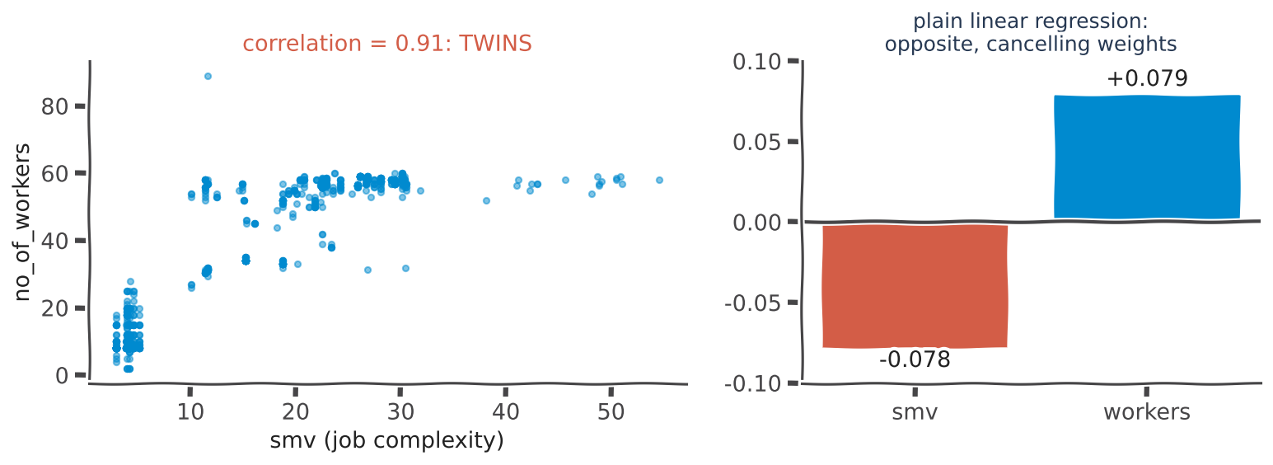
Twin features
~3 min
Multicollinearity: when features are twins
smv and workers: correlation 0.91 | Complex garments are made by big teams | Plain linear regression: -0.078 vs +0.079 - they cancel | A small change in data can flip them
In ML: interpretation breaks. Fix: select features or regularize (Part 2).
iTPU
Part 1 | Linear regression
Notes:
The model cannot tell which twin deserves the credit, so it pushes one up and the other down. Link to Topic 6: nearly dependent columns make XᵀX almost impossible to invert.

Slide 27
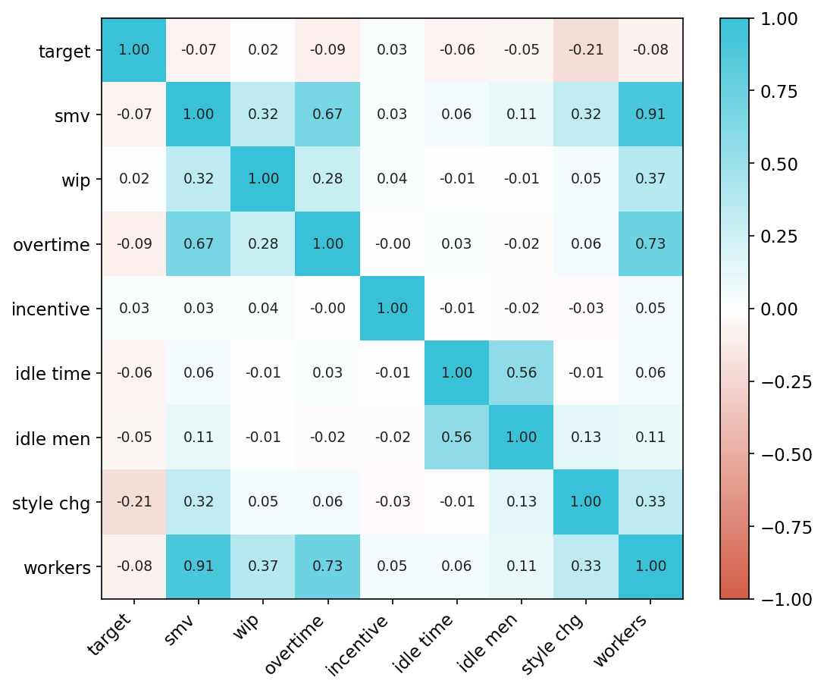
ACTIVITY | on your own
~4 min
Spot the twins
Dark teal = strong positive, coral = negative
1. Which pair of features has the strongest correlation?
2. List every other pair with correlation above 0.5
3. If you could keep only one twin, which would you keep, and why?
iTPU
Part 1 | Linear regression
Notes:
3 minutes on their own, then reveal on the next slide.

Slide 28
Answers
~1 min
Spot the twins - answers
1. Strongest pair
smv - workers: 0.91
2. Other pairs above 0.5
overtime - workers 0.73; overtime - smv 0.67; idle time - idle men 0.56
3. Keep one twin
e.g. workers: easy to measure and explain - or keep both and use Ridge
High correlation between FEATURES is a warning sign for linear models.
iTPU
Part 1 | Linear regression
Notes:
Discuss Q3 - there is no single right answer; the reasoning matters.

Slide 29
Recap
~2 min
Linear regression in 6 lines
The model
ŷ = b₀ + b₁x₁ + ... = X · w (weights are readable)
The loss
MSE = average squared error
OLS
exact formula b = (XᵀX)⁻¹Xᵀy - expensive for many features
In practice
gradient descent: w ← w - lr × gradient
Curves
polynomial / handcrafted features; watch overfitting
Twins
multicollinearity -> unstable weights -> select or regularize
iTPU
Part 1 | Linear regression
Notes:
Quick recap before Part 2.

Slide 30
PART 2
Regularization
Keep the weights on a leash
Notes:
Overfitting and twin features both show up as weights that are too big or too wild.

Slide 31
The idea
~3 min
Make big weights cost something
Loss = MSE + λ × penalty(weights)
λ = 0
small λ
huge λ
b₀ is free
plain linear regression - no leash
gentle shrinking - weights calm down
all weights -> 0: the model predicts the average (underfits)
the intercept is NOT penalised - it only sets the level
Analogy: a budget. The model may still use features, but every unit of weight costs money.
iTPU
Part 2 | Regularization
Notes:
Definition from the course: regularization reduces overfitting by restricting parameter values. λ (also called alpha in sklearn) is the knob.

Slide 32
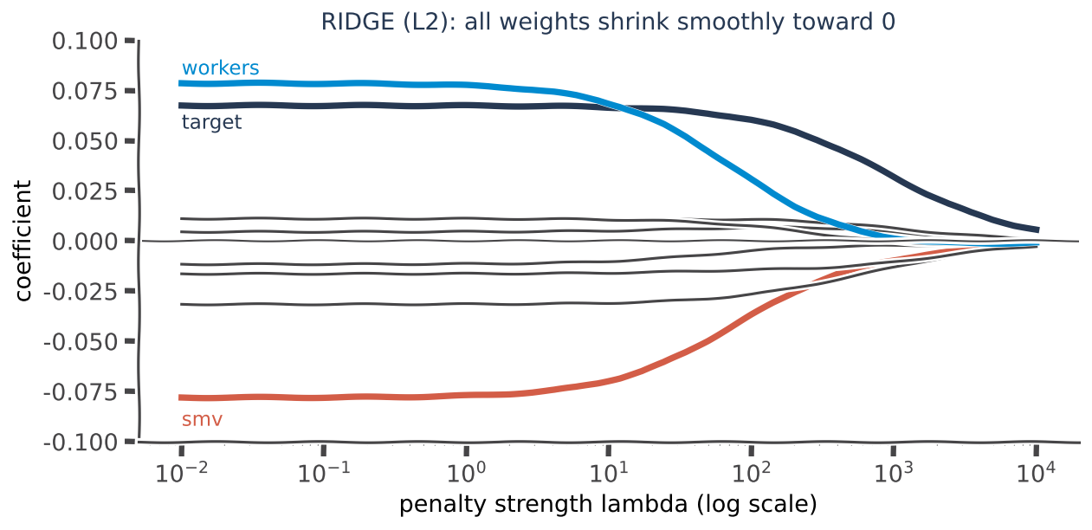
Ridge (L2)
~3 min
Ridge: shrink every weight
KEY IDEA
Penalty = λ × Σ w²
All weights shrink smoothly, rarely to exactly 0
Real: at λ = 100 the twins calm to -0.037 / +0.031
Best for multicollinearity and stable weights
In ML: Ridge splits the credit between twin features instead of letting them fight.
iTPU
Part 2 | Regularization
Notes:
Real Ridge path on our data. Left: plain regression values. Moving right, the red smv and blue workers lines approach each other and zero - the fight stops.

Slide 33
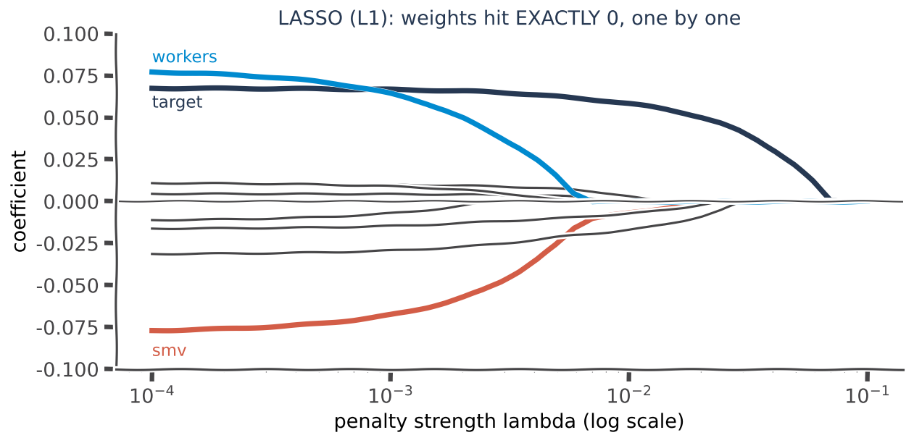
Lasso (L1)
~3 min
Lasso: shrink AND select
KEY IDEA
Penalty = λ × Σ |w|
Weak weights become EXACTLY 0 -> dropped
Real: λ = 0.01 keeps 5 of 9 features; test MSE 0.0222 vs 0.0216
λ ≈ 0.03: only 'target' survives = the most useful feature
In ML: automatic feature selection -> simpler, more interpretable models.
iTPU
Part 2 | Regularization
Notes:
Watch lines hit the zero axis and stay there. Lasso keeps smv and drops its twin workers - it picks one.

Slide 34
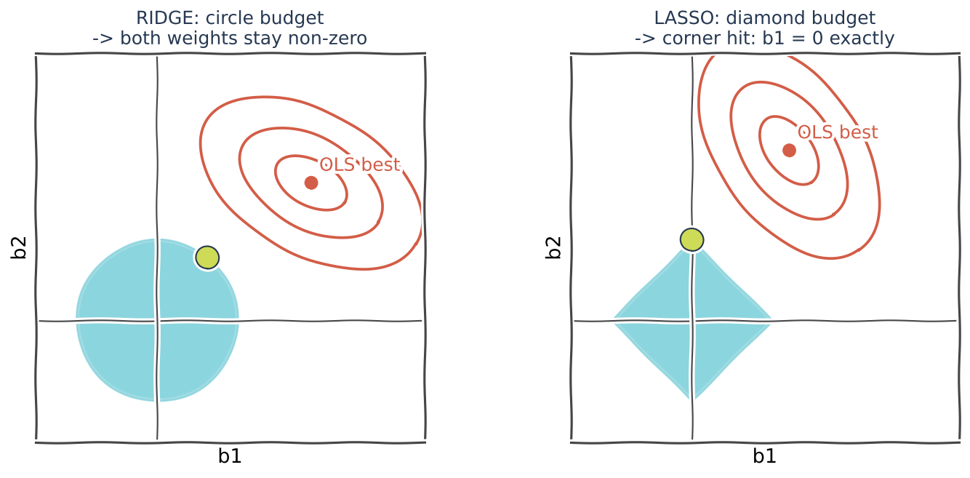
Why zeros?
~3 min
Why Lasso makes exact zeros and Ridge does not
KEY IDEA
Rings = equal-MSE lines around the best (OLS) point
Weights must stay inside the budget shape
Circle (Ridge): touches on the curve -> both non-zero
Diamond (Lasso): touches a CORNER on an axis -> a weight = 0
In ML: with many features the diamond has many corners -> many zeros.
iTPU
Part 2 | Regularization
Notes:
The classic picture. The solution is where the rings first touch the budget. Diamonds have sharp corners on the axes, circles do not.

Slide 35
Compare
~2 min
Ridge or Lasso? Real ML situations
Ridge (L2)
Lasso (L1)
Penalty
λ Σ w² (squares)
λ Σ |w| (absolute values)
Effect
shrinks all, keeps all
zeros weak weights
Twin features
shares the credit
keeps one, drops the other
Use when
features are correlated; you want stability
you want a short list of drivers
Example
house area + rooms; sensor readings
20,000 genes; 5,000 words in reviews
Can't decide? Elastic Net mixes both penalties.
iTPU
Part 2 | Regularization
Notes:
Answer the course's engaging question here: when is regularization important? Correlated features, more features than rows, need for a short list of drivers.

Slide 36
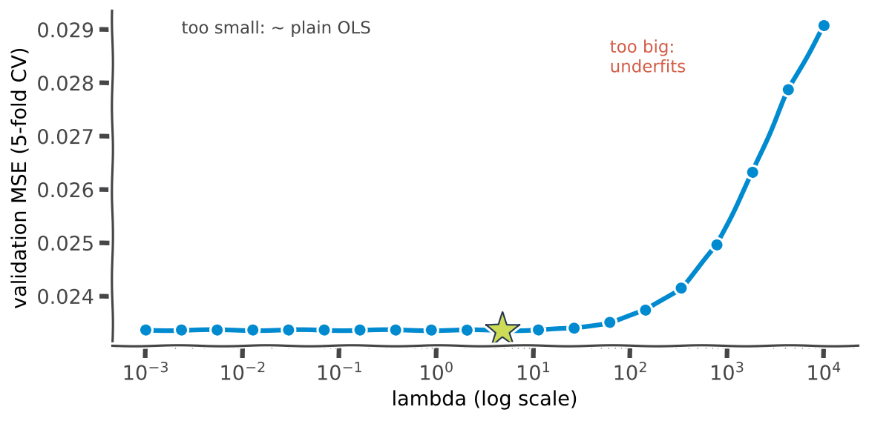
Choose λ
~3 min
How to choose λ: validation
KEY IDEA
Try many λ values, score each on validation data
Too small: same as plain OLS
Too big: underfits, error rises
Real best λ ≈ 5 - but the gain is small with only 9 features
In ML: RidgeCV / LassoCV / GridSearchCV try λ values for you.
iTPU
Part 2 | Regularization
Notes:
Real 5-fold cross-validation on our data. Honest message: with 9 features and 1,197 rows the model barely overfits, so regularization mainly adds stability. With thousands of features, it becomes essential.

Slide 37
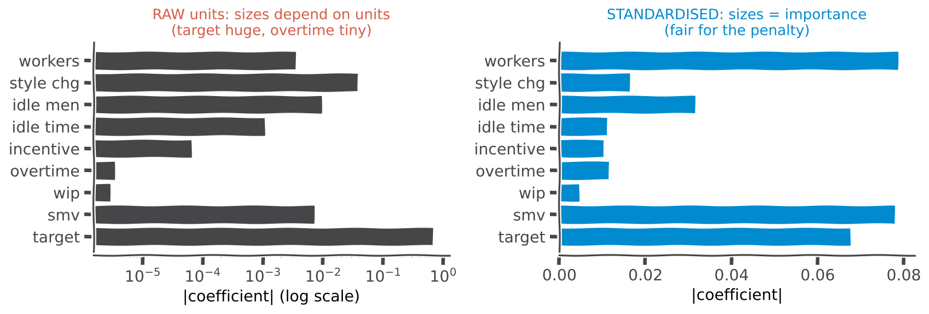
Normalise!
~3 min
Always normalise before regularizing
A weight's size depends on its feature's UNITS | overtime: 0 to 25,920 minutes -> tiny weight | target: 0.07 to 0.8 -> big weight | Standardise (Topic 5) so the penalty is fair
In ML: forgetting StandardScaler is the #1 regularization bug.
iTPU
Part 2 | Regularization
Notes:
Left: raw weights - sizes reflect units, not importance, so the penalty would crush the wrong features. Right: after standardising, sizes mean importance. Link back to the 'Be the model' Q4 trap.

Slide 38
ACTIVITY | on your own
~4 min
Ridge, Lasso or plain?
YOUR TASK
1. 20,000 genes, 200 patients - find the few genes that matter
Read each situation
Write: Ridge, Lasso, plain linear, or a warning
One sentence why
2. House area and number of rooms both in the model; weights jump every retrain
3. 3 features, 10,000 rows, train and test errors are similar
4. 5,000 words to predict a review score; the manager wants a short list
5. You applied Ridge to raw features: salary in $ and age in years
iTPU
Part 2 | Regularization
Notes:
Answers next slide.

Slide 39
Answers
~1 min
Ridge, Lasso or plain? - answers
1. 20,000 genes, 200 patients
Lasso - selects a few genes
2. area + rooms, unstable
Ridge - calms correlated twins
3. 3 features, no overfitting
Plain linear - no need for a leash
4. 5,000 words, short list
Lasso - zeros most words
5. Ridge on raw units
WARNING: standardise first!
iTPU
Part 2 | Regularization
Notes:
Discuss 5: salary in dollars gets a tiny weight and is barely penalised, age gets penalised hard - unfair.

Slide 40
MENTI | Quiz
~1 min
menti.com code: ____ ____
Which penalty can set a weight to EXACTLY zero?
A) Ridge (L2)
B) Lasso (L1)
C) Both
D) Neither
Vote on your phone now - 45 seconds
Notes:
Answer: B - the diamond's corners.

Slide 41
MENTI | True or false
~1 min
menti.com code: ____ ____
'Regularization should be applied to raw, unscaled features.'
A) True
B) False
Vote on your phone now - 45 seconds
Notes:
Answer: False. Standardise first so every weight is judged on the same scale.

Slide 42
Recap
~2 min
Regularization in 5 lines
Idea
loss = MSE + λ × penalty; λ is the strength knob
Ridge (L2)
λ Σ w²: shrinks all; great for twin features
Lasso (L1)
λ Σ |w|: exact zeros -> feature selection
Choose λ
cross-validation; too big underfits
Must do
standardise features first; don't penalise b₀
iTPU
Part 2 | Regularization
Notes:
Recap before Part 3.

Slide 43
PART 3
Logistic regression
Classification wearing a regression name
Notes:
Now the target is yes/no: is this team highly productive (actual >= 0.75)?

Slide 44
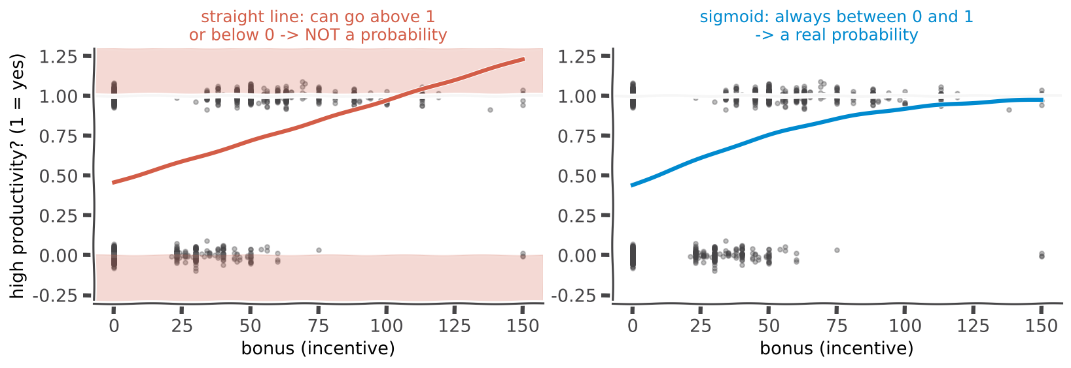
The problem
~3 min
Why not a straight line for yes/no?
Target is 0 (no) or 1 (yes): high productivity? | A straight line gives -0.2 or 1.3: not a probability | We need an S-shaped squeeze into 0...1
In ML: the model must output a probability we can trust and threshold.
iTPU
Part 3 | Logistic regression
Notes:
Grey dots: real teams at 0 or 1, spread by bonus. Left: the line escapes 0-1. Right: the sigmoid stays inside.

Slide 45
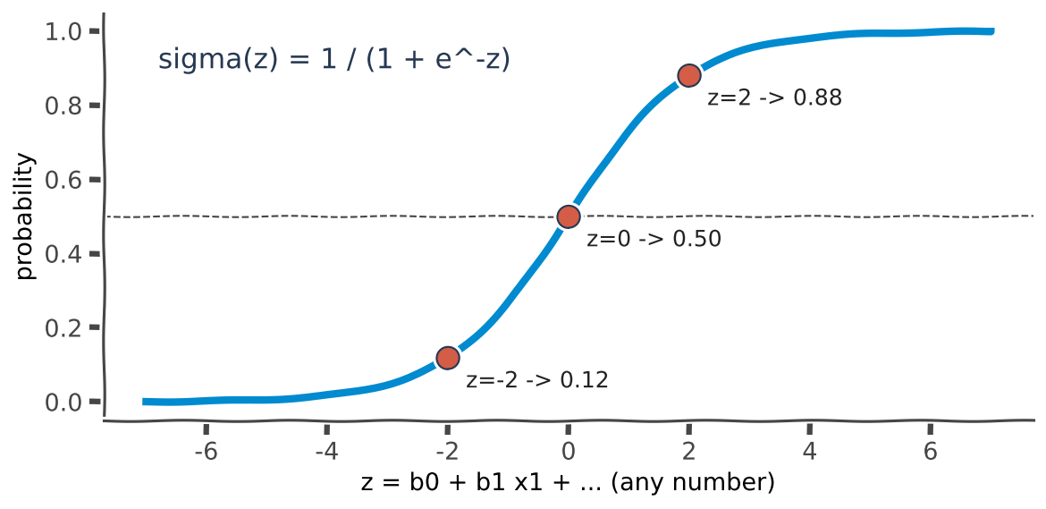
Sigmoid
~3 min
The sigmoid function
KEY IDEA
z = b₀ + b₁x₁ + ... (same linear formula, any number)
p = σ(z) = 1 / (1 + e⁻ᶻ) (always between 0 and 1)
z = 0 -> 0.50; z = 2 -> 0.88; z = -2 -> 0.12
Called 'regression': log-odds are linear in the features
In ML: logistic = linear regression + sigmoid. The output is a Bernoulli probability (Topic 8).
iTPU
Part 3 | Logistic regression
Notes:
Say it slowly: compute the same weighted sum as before, then squash it. Big positive -> near 1, big negative -> near 0.

Slide 46
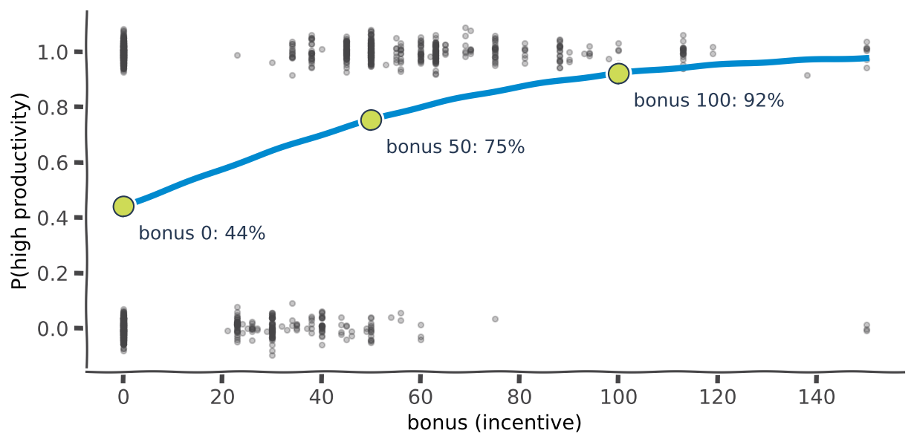
Real model
~3 min
Real model: does a bonus help?
KEY IDEA
Target: high productivity (actual ≥ 0.75) - 60% of team-days
P(high) = σ(-0.23 + 0.027 × bonus)
Bonus 0 -> 44%; 50 -> 75%; 100 -> 92%
All 9 features: 70% accuracy vs 60% baseline
In ML: a probability lets managers rank teams and plan, not just label them.
iTPU
Part 3 | Logistic regression
Notes:
Real curve fitted on our data. Grey dots are teams at 0 (not high) or 1 (high). The bonus clearly raises the chance of high productivity.

Slide 47
ACTIVITY | on your own
~4 min
Be the classifier
YOUR TASK
1. Team A has z = -1. Probability? Class with threshold 0.5?
Use this table: z = -2 -> 0.12, -1 -> 0.27, 0 -> 0.50, 1 -> 0.73, 2 -> 0.88
Probability = σ(z)
Class = HIGH if probability ≥ threshold
2. Team B has z = 2. Probability? Class with threshold 0.5?
3. Team C has z = 0. Class with threshold 0.5? With 0.8?
4. Team D has z = 1. Class with threshold 0.5? With 0.8?
iTPU
Part 3 | Logistic regression
Notes:
Answers next slide.

Slide 48
Answers
~1 min
Be the classifier - answers
A: z = -1
0.27 -> NOT high (both thresholds)
B: z = 2
0.88 -> HIGH (both thresholds)
C: z = 0
0.50 -> HIGH at 0.5; NOT at 0.8
D: z = 1
0.73 -> HIGH at 0.5; NOT at 0.8
Same probabilities, different threshold -> different decisions. The threshold is a choice.
iTPU
Part 3 | Logistic regression
Notes:
Leads straight into the threshold slide.

Slide 49
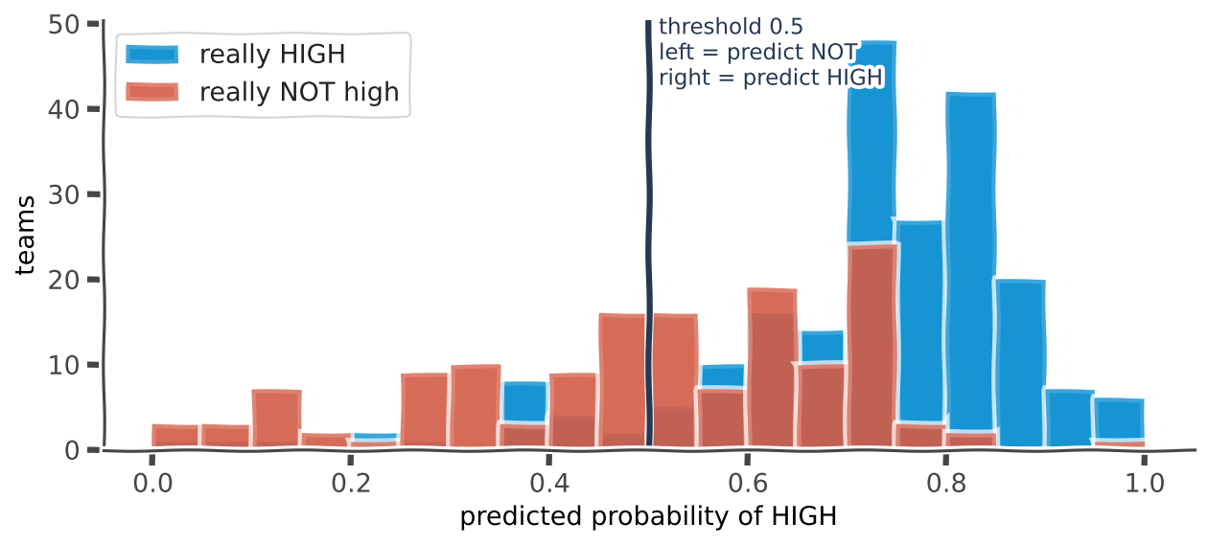
Threshold
~3 min
Threshold: from probability to decision
KEY IDEA
Default: predict HIGH if p ≥ 0.5
Lower threshold: catch more positives, more false alarms
Higher threshold: cautious, miss some positives
Choose by the COST of each mistake
In ML: cancer screening -> low threshold; spam filter -> high (never lose a real email).
iTPU
Part 3 | Logistic regression
Notes:
Real test-set probabilities. Blue = really high, coral = really not. They overlap, so any threshold makes some mistakes. Slide the line in your head and ask which mistake you prefer.

Slide 50
MENTI | Quiz
~2 min
menti.com code: ____ ____
A bank flags FRAUD. Missing a fraud is very expensive; checking a normal payment is cheap. Which threshold?
A) 0.2 (flag a lot)
B) 0.5 (default)
C) 0.9 (flag only when very sure)
Vote on your phone now - 45 seconds
Notes:
Answer: A. When missing a positive is costly, lower the threshold and accept more false alarms.

Slide 51
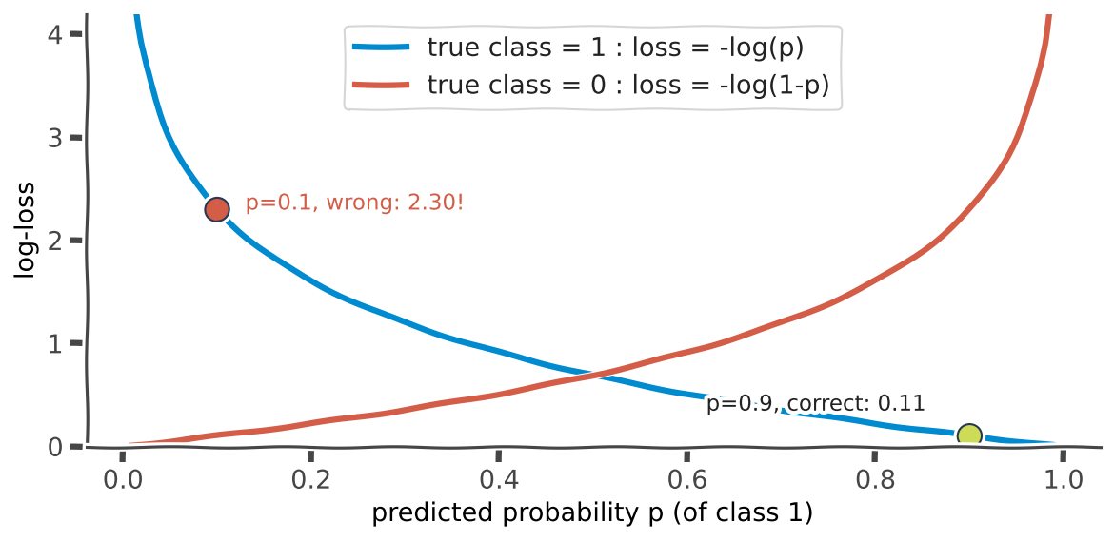
How it learns
~3 min
Maximum likelihood and log-loss
KEY IDEA
Choose weights that make the observed labels MOST probable
= minimise log-loss: -[y log p + (1-y) log(1-p)]
Right and confident (p = 0.9): loss 0.11
Wrong and confident (p = 0.1): loss 2.30!
No formula -> always trained with gradient descent
In ML: log-loss punishes over-confident mistakes - it is also how neural classifiers train.
iTPU
Part 3 | Logistic regression
Notes:
Blue curve: true class 1. The loss explodes as the predicted probability goes to 0 - confident mistakes are very expensive.

Slide 52
Odds
~3 min
Reading logistic weights: odds
Odds
Log-odds are linear
Weight -> multiplier
odds = p / (1 - p)
p = 0.75 -> odds 3
('3 to 1')
log(odds) = z = b₀ + b₁x₁ + ...
that's the 'regression' in the name
e^(b₁) = how odds change per +1
bonus: e^0.027 = 1.027 (+2.7%)
+10 bonus: × 1.31 (+31%)
bonus 0
z = -0.23, odds = 0.79, p = 44%
bonus 10
z = 0.04, odds = 1.04, p = 51%
iTPU
Part 3 | Logistic regression
Notes:
Optional depth. Positive weight -> higher odds. Each extra 10 units of bonus multiplies the odds of high productivity by about 1.31.

Slide 53
MENTI | Quiz
~1 min
menti.com code: ____ ____
Logistic regression is mainly used for...
A) Predicting a number
B) Classification (yes/no, categories)
C) Clustering
D) Reducing the number of features
Vote on your phone now - 45 seconds
Notes:
Answer: B - despite its name.

Slide 54
Recap
~2 min
Logistic regression in 5 lines
Model
p = σ(X · w): linear formula + sigmoid
Decision
class = 1 if p ≥ threshold (default 0.5)
Threshold
a business choice: which mistake costs more?
Training
maximum likelihood = minimise log-loss, via gradient descent
Reading
e^(weight) = odds multiplier per +1 of the feature
iTPU
Part 3 | Logistic regression
Notes:
Recap.

Slide 55
Practice
~4 min
From maths to code: your 4 AutoCode exercises
Model
Prediction
Gradient of the loss
1. Linear
ŷ = X w
(2/n) Xᵀ(Xw - y)
2. Ridge
ŷ = X w
(2/n) Xᵀ(Xw - y) + 2λw
3. Lasso
ŷ = X w
(2/n) Xᵀ(Xw - y) + λ · sign(w)
4. Logistic
p = σ(X w); class = p ≥ 0.5
(1/n) Xᵀ(σ(Xw) - y)
Training is already written in the base class AnalyticalModel (tasks/base.py) using gradient descent - you implement only the GRADIENT and the PREDICTION.
One test runs your models on this garment dataset (data/dataloader.py) and checks they beat the baseline.
Checked automatically in AutoCode by unit tests. Dataset info: archive.ics.uci.edu/dataset/597
iTPU
Topic 9 | Regression Algorithms
Notes:
The two notes from the course outline. Point out: Ridge and Lasso are linear plus one term; logistic has the same shape as linear with a sigmoid inside. Check the base class for 1/n vs 1/(2n) and bias handling.

Slide 56
MENTI | Final challenge
~4 min
Final challenge - quiz mode, leaderboard!
1. Linear regression minimises...? (MSE / accuracy / log-loss)
2. Train error tiny, test error huge = ? (underfit / overfit / leakage)
3. Exact zeros come from...? (Ridge / Lasso)
4. Before Ridge or Lasso you must...? (standardise / add noise / shuffle labels)
5. Logistic output passes through the...? (sigmoid / square / log)
6. σ(0) = ? (0 / 0.5 / 1)
7. Fraud detection threshold should be...? (low / 0.5 / high)
8. Large data: OLS formula or gradient descent?
Fastest correct answers win!
Notes:
Build 8 Menti Quiz questions, 20 s each. Answers: 1 MSE, 2 overfit, 3 Lasso, 4 standardise, 5 sigmoid, 6 0.5, 7 low, 8 gradient descent.

Slide 57
Big picture
~2 min
The whole family on one page
Model
Predicts
Loss
What it adds
Linear
a number
MSE
weighted sum X · w
Polynomial
a number (curved)
MSE
x², x³... columns (watch overfitting)
Ridge (L2)
a number
MSE + λΣw²
calm, stable weights
Lasso (L1)
a number
MSE + λΣ|w|
feature selection (zeros)
Logistic
a class via a probability
log-loss
sigmoid + threshold
Same formula X · w, same gradient descent - only the LOSS and the OUTPUT change.
iTPU
Topic 9 | Regression Algorithms
Notes:
The one sentence to remember.

Slide 58
MENTI | Open ended - exit ticket
~2 min
menti.com code: ____ ____
1) One regression model I could use in my own project. 2) One thing that is still confusing.
Live answers appear here on Menti
Answer both on menti.com
Notes:
Read some answers; use 'confusing' ones to open the practice session.

Slide 59
iTPU
Thank you!
Questions? Next: implement all four models in AutoCode
Linear | Ridge | Lasso | Logistic - gradient + prediction only
Notes:
Close. Invite questions and examples from their own work, as in the course outline.

